Slide 1
Supervised vs. Unsupervised Learning
Supervised learning (classification)
Supervision: The training data (observations, measurements, etc.) are accompanied by labels indicating the class of the observations
New data is classified based on the training set
Unsupervised learning (clustering)
The class labels of training data is unknown
Given a set of measurements, observations, etc. with the aim of establishing the existence of classes or clusters in the data

Slide 2
Classification—A Two-Step Process
Model construction: describing a set of predetermined classes
Each tuple/sample is assumed to belong to a predefined class, as determined by the class label attribute
The set of tuples used for model construction is training set
The model is represented as classification rules, decision trees, or mathematical formulae
Model usage: for classifying future or unknown objects
Estimate accuracy of the model
The known label of test sample is compared with the classified result from the model
Accuracy rate is the percentage of test set samples that are correctly classified by the model
Test set is independent of training set
If the accuracy is acceptable, use the model to classify new data
Note: If the test set is used to select models, it is called validation (test) set

Slide 3
Process (1): Model Construction
Classification
Algorithms
Training
Data
Classifier
(Model)
IF rank = ‘professor’
OR years > 6
THEN tenured = ‘yes’

Slide 4
Process (2): Using the Model in Prediction
Classifier
Testing
Data
Unseen Data
(Jeff, Professor, 4)
Tenured?

Slide 5
Chapter 8. Classification: Basic Concepts
Classification: Basic Concepts
Decision Tree Induction
Bayes Classification Methods
Rule-Based Classification
Model Evaluation and Selection
Techniques to Improve Classification Accuracy: Ensemble Methods
5
Notes:
5

Slide 6
Decision Tree Induction
Decision tree induction is the learning of decision trees from class-labeled training tuples.
A decision tree is a flowchart-like tree structure, where each internal node (non-leaf node) denotes a test on an attribute, each branch represents an outcome of the test, and each leaf node (or terminal node) holds a class label.

Slide 7
Decision Tree Induction
The topmost node in a tree is the root node.
Internal nodes are denoted by rectangles, and leaf nodes are denoted by ovals.
Some decision tree algorithms produce only binary trees (where each internal node branches to exactly two other nodes), whereas others can produce nonbinary trees.
Decision trees can easily be converted to classification rules.

Slide 8
Why are decision tree classifiers so popular?
The construction of decision tree classifiers does not require any domain knowledge or parameter setting, and therefore is appropriate for exploratory knowledge discovery.
Decision trees can handle multidimensional data. Their representation of acquired knowledge in tree form is intuitive and generally easy to assimilate by humans.
The learning and classification steps of decision tree induction are simple and fast.
In general, decision tree classifiers have good accuracy.
However, successful use may depend on the data at hand.
Decision tree induction algorithms have been used for classification in many application areas such as medicine, manufacturing and production, financial analysis, astronomy, and molecular biology

Slide 9
Decision Tree Induction: An Example
Training data set: Buys_computer
The data set follows an example of Quinlan’s ID3 (Playing Tennis)
Resulting tree:
age?
<=30
overcast
>40
31..40
student?
yes
credit rating?
no
yes
excellent
fair
no
yes
no
yes

Slide 10
Algorithm for Decision Tree Induction
Basic algorithm (a greedy algorithm)
Tree is constructed in a top-down recursive divide-and-conquer manner
At start, all the training examples are at the root
Attributes are categorical (if continuous-valued, they are discretized in advance)
Examples are partitioned recursively based on selected attributes
Test attributes are selected on the basis of a heuristic or statistical measure (e.g., information gain)
Conditions for stopping partitioning
All samples for a given node belong to the same class
There are no remaining attributes for further partitioning – majority voting is employed for classifying the leaf
There are no samples left
Notes:
Heuristics : enabling a person to discover or learn something for themselves.

Slide 11
Algorithm for Decision Tree Induction
Algorithm: Generate a decision tree from the training tuples of data partition, D.
Input:
Data partition, D, which is a set of training tuples and their associated class labels;
attribute list, the set of candidate attributes;
Attribute selection method, a procedure to determine the splitting criterion that “best” partitions the data tuples into individual classes. This criterion consists of a splitting attribute and, possibly, either a split-point or splitting subset.
Output: A decision tree.

Slide 12
Method:
(1) create a node N;
(2) if tuples in D are all of the same class, C, then
(3) return N as a leaf node labeled with the class C;
(4) if attribute list is empty then
(5) return N as a leaf node labeled with the majority class in D; // majority voting
(6) apply Attribute selection method(D, attribute list) to find the “best” splitting criterion;
(7) label node N with splitting criterion;
(8) if splitting attribute is discrete-valued and multiway splits allowed then
(9) attribute list <- attribute list - splitting attribute; // remove splitting attribute
(10) for each outcome j of splitting criterion
// partition the tuples and grow subtrees for each partition
(11) let Dj be the set of data tuples in D satisfying outcome j; // a partition
(12) if Dj is empty then
(13) attach a leaf labeled with the majority class in D to node N;
(14) else attach the node returned by Generate decision tree(Dj , attribute list) to node N;
endfor
(15) return N;

Slide 13
Algorithm for Decision Tree Induction
The splitting criterion tells us which attribute to test at node N by determining the “best” way to separate or partition the tuples in D into individual classes (step 6).
The splitting criterion also tells us which branches to grow from node N with respect to the outcomes of the chosen test.
More specifically, the splitting criterion indicates the splitting attribute and may also indicate either a split-point or a splitting subset. The splitting criterion is determined so that, ideally, the resulting partitions at each branch are as “pure” as possible. A partition is pure if all the tuples in it belong to the same class.
In other words, if we split up the tuples in D according to the mutually exclusive outcomes of the splitting criterion, we hope for the resulting partitions to be as pure as possible.

Slide 14
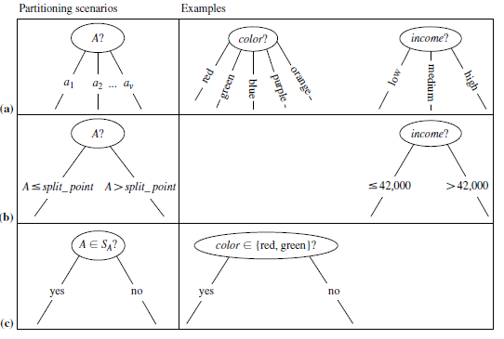
Algorithm for Decision Tree Induction

Slide 15
Attribute Selection Measure: Information Gain (ID3/C4.5)
Select the attribute with the highest information gain
Let p_{i} be the probability that an arbitrary tuple in D belongs to class C_{i}, estimated by |C_{i, D}|/|D|
Expected information (Entropy) needed to classify a tuple in D:
Information needed (after using A to split D into v partitions) to classify D:
Information gained by branching on attribute A
Notes:
I : the expected information needed to classify a given sample
E (entropy) : expected information based on the partitioning into subsets by A

Slide 16
Attribute Selection: Information Gain
Class P: buys_computer = “yes”
Class N: buys_computer = “no”
means “age <=30” has 5 out of 14 samples, with 2 yes’es and 3 no’s. Hence
Similarly,

Slide 17

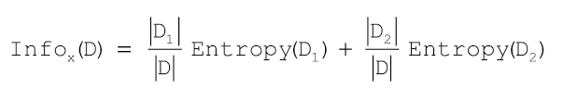
Computing Information-Gain for Continuous-Valued Attributes
Let attribute A be a continuous-valued attribute
Must determine the best split point for A
Sort the value A in increasing order
Typically, the midpoint between each pair of adjacent values is considered as a possible split point
(a_{i}+a_{i+1})/2 is the midpoint between the values of a_{i} and a_{i+1}
The point with the minimum expected information requirement for A is selected as the split-point for A
Split:
D1 is the set of tuples in D satisfying A ≤ split-point, and D2 is the set of tuples in D satisfying A > split-point

Slide 18
Information-Gain Drawback
The information gain measure is biased toward tests with many outcomes. That is, it prefers to select attributes having a large number of values.
For example, consider an attribute that acts as a unique identifier such as product ID. A split on product ID would result in a large number of partitions (as many as there are values), each one containing just one tuple. Because each partition is pure, the information required to classify dataset D based on this partitioning would be
Therefore, the information gained by partitioning on this attribute is maximal. Clearly, such a partitioning is useless for classification

Slide 19
Gain Ratio for Attribute Selection (C4.5)
C4.5 (a successor of ID3) uses gain ratio to overcome the problem (normalization to information gain)
GainRatio(A) = Gain(A)/SplitInfo(A)
Ex.
gain_ratio(income) = 0.029/1.557 = 0.019
The attribute with the maximum gain ratio is selected as the splitting attribute

Slide 20
Gini Index (CART, IBM IntelligentMiner)
If a data set D contains examples from n classes, gini index, gini(D) is defined as
where p_{j} is the relative frequency of class j in D
If a data set D is split on A into two subsets D₁ and D₂, the gini index gini(D) is defined as
Reduction in Impurity:
The attribute provides the smallest gini_{split}(D) (or the largest reduction in impurity) is chosen to split the node (need to enumerate all the possible splitting points for each attribute)

Slide 21
Gini Index
The Gini index considers a binary split for each attribute.
Let’s first consider the case where A is a discrete-valued attribute having v distinct values, {a1, a2, : : : , av}, occurring in D.
To determine the best binary split on A, we examine all the possible subsets that can be formed using known values of A. Each subset, SA, can be considered as a binary test for attribute A of the form “A belongs SA?” Given a tuple, this test is satisfied if the value of A for the tuple is among the values listed in SA. If A has v possible values, then there are 2^{v} possible subsets

Slide 22

Gini Index
For example, if income has three possible values, namely {low, medium, high}, then the possible subsets are {low, medium, high}, {low,medium}, {low, high}, {medium, high}, {low}, {medium}, {high}, and {}.
We exclude the power set, {low, medium, high}, and the empty set from consideration since, conceptually, they do not represent a split. Therefore, there are 2v-2 possible ways to form two partitions of the data, D, based on a binary split on A.
When considering a binary split, we compute a weighted sum of the impurity of each resulting partition. For example, if a binary split on A partitions D into D1 and D2, the Gini index of D given that partitioning is

Slide 23

Gini Index
For each attribute, each of the possible binary splits is considered. For a discrete-valued attribute, the subset that gives the minimum Gini index for that attribute is selected as its splitting subset.
For continuous-valued attributes, each possible split-point must be considered. The strategy is similar to that described earlier for information gain, where the midpoint between each pair of (sorted) adjacent values is taken as a possible split-point. The point giving the minimum Gini index for a given (continuous-valued) attribute is taken as the split-point of that attribute. Recall that for a possible split-point of A, D1 is the set of tuples in D satisfying A split point, and D2 is the set of tuples in D satisfying A > split point.

Slide 24
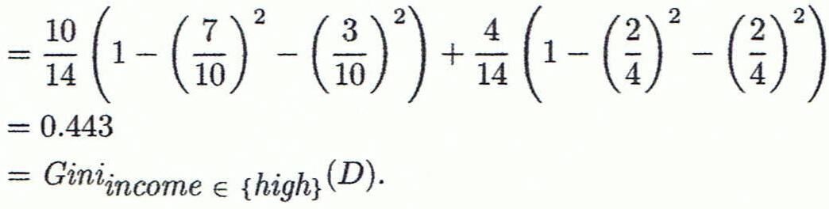
Computation of Gini Index
Ex. D has 9 tuples in buys_computer = “yes” and 5 in “no”
Suppose the attribute income partitions D into 10 in D₁: {low, medium} and 4 in D₂
Gini_{{low,high}} is 0.458; Gini_{{medium,high}} is 0.450. Thus, split on the {low,medium} (and {high}) since it has the lowest Gini index
All attributes are assumed continuous-valued
May need other tools, e.g., clustering, to get the possible split values

Slide 25
Computation of Gini Index
Evaluating age , we obtain { youth, senior } (or { middle aged}) as the best split for age with a Gini index of 0.357;
the attributes student and credit rating are both binary, with Gini index values of 0.367 and 0.429, respectively.
The attribute age and splitting subset {youth, senior} therefore give the minimum Gini index overall, with a reduction in impurity of 0.459 −0.357=0.102.
The binary split “age∈{youth, senior?}” results in the maximum reduction in impurity of the tuples in D and is returned as the splitting criterion.
Node N is labeled with the criterion, two branches are grown from it, and the tuples are partitioned accordingly.

Slide 26
Comparing Attribute Selection Measures
The three measures, in general, return good results but
Information gain:
biased towards multivalued attributes
Gain ratio:
tends to prefer unbalanced splits in which one partition is much smaller than the others
Gini index:
biased to multivalued attributes
has difficulty when # of classes is large
tends to favor tests that result in equal-sized partitions and purity in both partitions

Slide 27
Other Attribute Selection Measures
CHAID: a popular decision tree algorithm, measure based on χ² test for independence
C-SEP: performs better than info. gain and gini index in certain cases
G-statistic: has a close approximation to χ² distribution
MDL (Minimal Description Length) principle (i.e., the simplest solution is preferred):
The best tree as the one that requires the fewest # of bits to both (1) encode the tree, and (2) encode the exceptions to the tree
Multivariate splits (partition based on multiple variable combinations)
CART: finds multivariate splits based on a linear comb. of attrs.
Which attribute selection measure is the best?
Most give good results, none is significantly superior than others

Slide 28
Overfitting and Tree Pruning
Overfitting: An induced tree may overfit the training data
Too many branches, some may reflect anomalies due to noise or outliers
Poor accuracy for unseen samples
Pruned trees tend to be smaller and less complex and, thus, easier to comprehend. They are usually faster and better at correctly classifying independent test data (i.e., of previously unseen tuples) than unpruned trees.

Slide 29
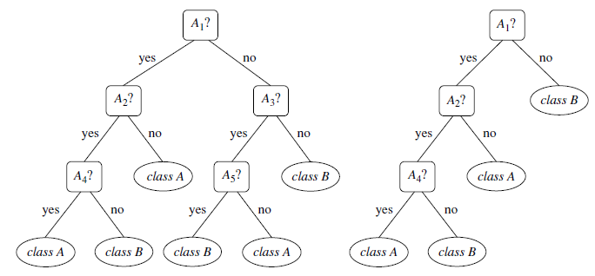
Tree Pruning

Slide 30
Overfitting and Tree Pruning
Two approaches to avoid overfitting
Prepruning: Halt tree construction early ̵ do not split a node if this would result in the goodness measure falling below a threshold
Difficult to choose an appropriate threshold
Postpruning: Remove branches from a “fully grown” tree—get a sequence of progressively pruned trees
Use a set of data different from the training data to decide which is the “best pruned tree”

Slide 31
Overfitting and Tree Pruning
Two approaches to avoid overfitting
Prepruning: Halt tree construction early ̵ do not split a node if this would result in the goodness measure falling below a threshold
When constructing a tree, measures such as statistical significance, information gain, Gini index, and so on, can be used to assess the goodness of a split. If partitioning the tuples at a node would result in a split that falls below a prespecified threshold, then further partitioning of the given subset is halted.High thresholds could result in oversimplified trees, whereas low thresholds could result in very little simplification.
Difficult to choose an appropriate threshold
Postpruning: Remove branches from a “fully grown” tree—get a sequence of progressively pruned trees
A subtree at a given node is pruned by removing its branches and replacing it with a leaf. The leaf is labeled with the most frequent class among the subtree being replaced.
Use a set of data different from the training data to decide which is the “best pruned tree”

